Slide 1

ESE 4009
INSTRUCTOR: Prof. Mike Aleshams
Group 6

Slide 2
IoT based Cradle system using SIDS monitor

Slide 3
Group Members
Rohan Yadav | C0773871 | ROHAN
Shahrukh Padaniya | C0769542 | SHAHRUKH
Swapnil Sevak | C0777195 | SWAPNIL
Vandana Eaga | C0777215 | VANDANA

Slide 4

Raspberry Pi Interfacing

Slide 5
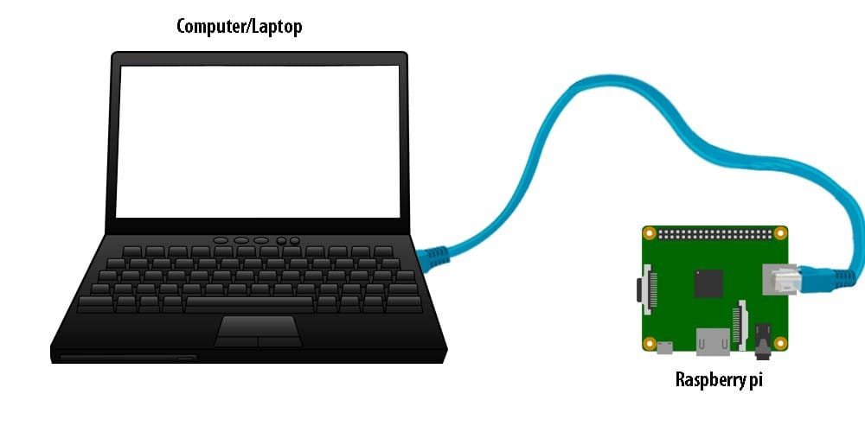

Slide 6
Materials required
Raspberry Pi 3
LAN cable
SD card and adapter

Slide 7
Raspberry Pi3
SOC: Broadcom BCM2837B0, Cortex-A53 (ARMv8) 64-bit SoC
CPU: 1.4GHz 64-bit quad-core ARM Cortex-A53 CPU
RAM: 1GB LPDDR2 SDRAM
WIFI: Dual-band 802.11ac wireless LAN (2.4GHz and 5GHz ) and Bluetooth 4.2
Ethernet: Gigabit Ethernet over USB 2.0 (max 300 Mbps). Power-over-Ethernet support (with separate PoE HAT). Improved PXE network and USB mass-storage booting.
Thermal management: Yes
Video: Yes – VideoCore IV 3D. Full-size HDMI
Audio: Yes
USB 2.0: 4 ports
GPIO: 40-pin
Power: 5V/2.5A DC power input
Operating system support: Linux and Unix

Slide 8
LAN cable
A LAN cable, by definition, is a cable that links PCs to network switches, and then from the switch to a router, modem, or DSL, which provides internet connectivity from a provider.
A LAN is formed when these devices are connected via a wireless LAN, ethernet, or networking cable.

Slide 9
SD card and adapter
SD card will be used in interfacing of Raspberry Pi to load OS and make it bootable.
After making it bootable we can insert it into raspberry Pi for interfacing

Slide 10
Software required
SD card formatter
Disk Imager
VNC viewer
PuTTY

Slide 11
SD card formatter
SD Card Formatter is a tool that allows you to access all memory card formats, including SD, SDHC, and SCXC, quickly and easily.
It was created so that you may delete all of the content on your SD card in one go.

Slide 12
Disk Imager
It will use to load disk image of Raspberry Pi OS on SD card.
A disc image is a copy of a storage device's entire contents, such as a hard drive, DVD, or CD.
The disc image contains both data and structure information, and represents the content exactly as it appears on the original storage medium.
A virtual hard disc can be created from a disc image of a hard drive (VHD)

Slide 13
VNC viewer
Virtual Network Computing (VNC) is a graphical desktop-sharing system that employs the Remote Frame Buffer protocol (RFB) to control another computer remotely in computing.
Remote technical help and viewing files on one's work computer from one's home computer, or vice versa, are two common applications for this technology.

Slide 14
PuTTY
PuTTY is a terminal emulator, serial console, and network file transfer application that is free and open-source.
SCP, SSH, Telnet, rlogin, and raw socket connections are among the network protocols it supports.
It also has the ability to connect to a serial port.

Slide 15
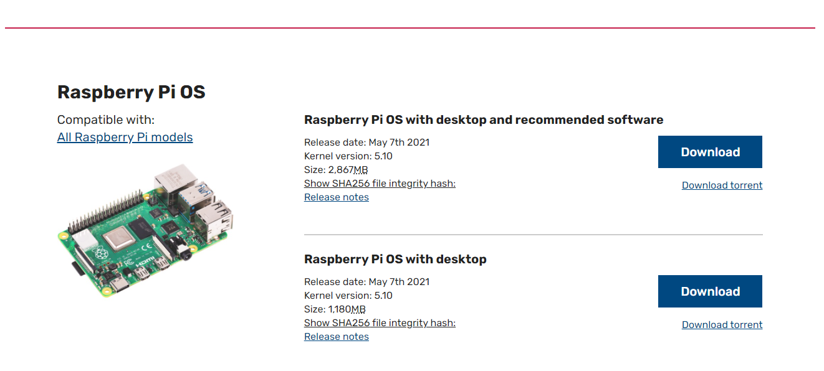
First of all we need to download required OS from https://www.raspberrypi.org

Slide 16
Than we need to format the SD card using SD card formatter.
After formatting the SD card we need to make our SD card bootable using Disk Imager.

Slide 17

For that, we need to select our downloaded file of Raspberry Pi OS and attach it into SD card.
After completing above steps, we need to create a empty file named “ssh” without any extension in boot partition.
It will automatically enables “SSH” on boot and then deletes it.

Slide 18
Then we need to remove SD card and insert it into our Raspberry Pi.
Then connect LAN cable from rapberry and power it up using USB cable.
After that, we need to enter the command “ifconfig” to configure Raspberry Pi.

Slide 19
Also, we need to enable VNC to share screen under interfaces.
Default username is “pi” and password is “raspberry”.

Slide 20
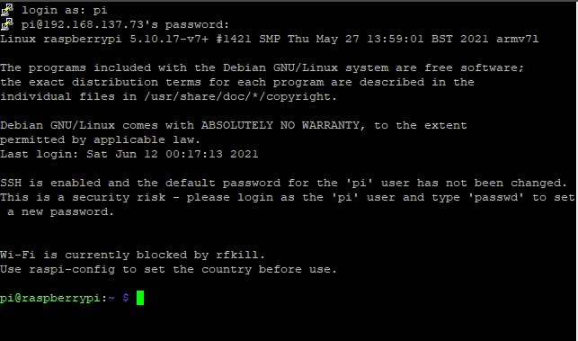
Then we need to enter the command “sudo raspi-config” to configure raspberry pi.

Slide 21
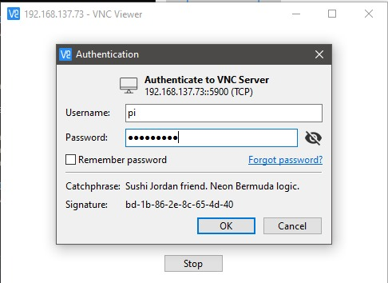
We need select Desktop Autologin under boot options.
After that, we need to open VNC viewer.

Slide 22
We need to type “raspberry.local” under server address type.
Then login to the device using default username and password stated earlier.

Slide 23
Then at the end, we need to configure the raspberry pi by setting up the country, language and time zone.

Slide 24
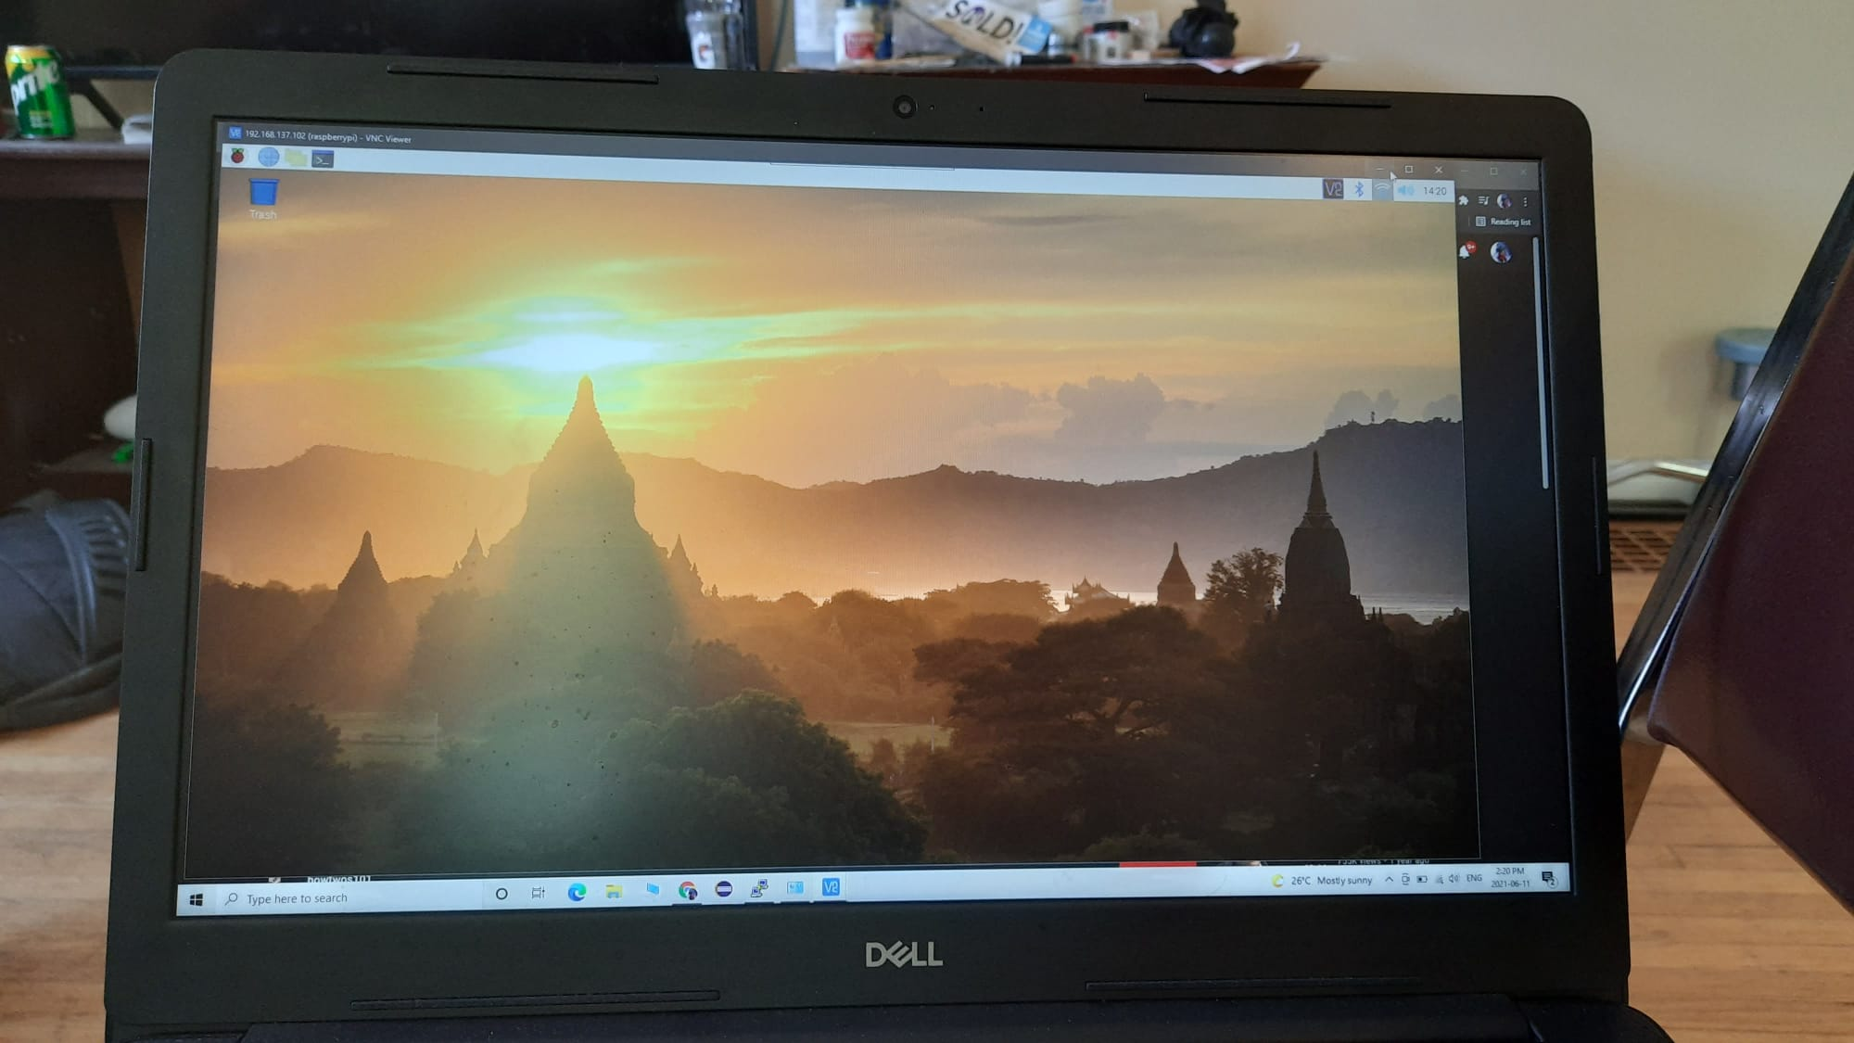

Slide 25
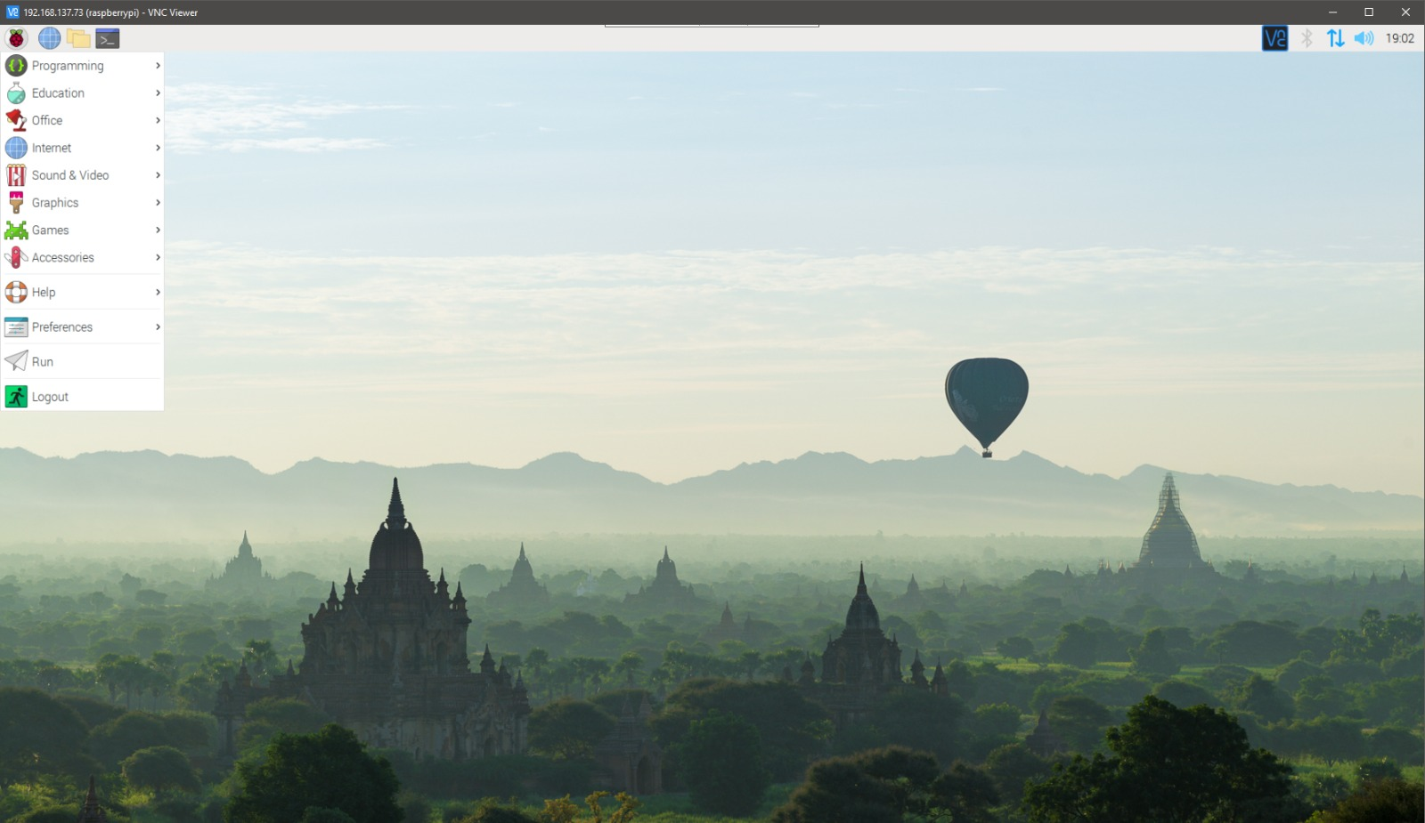

Slide 26
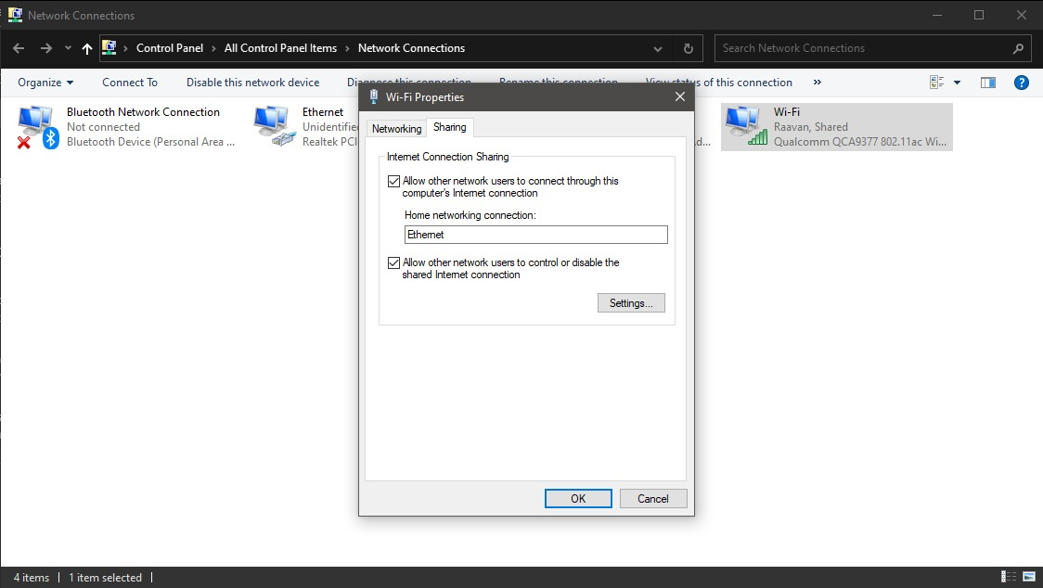
Wifi connection and settings should be as shown in image.

Slide 27
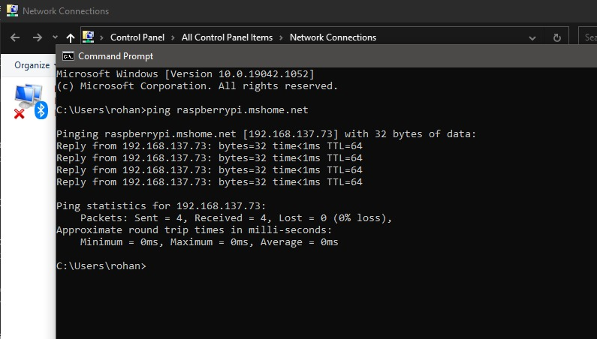
To know the IP address

Slide 28
References
To download OS https://www.raspberrypi.org/software/operating-systems/#raspberry-pi-os-32-bit
https://infinity-cable-products.com/blogs/terms/what-is-a-lan-cable-and-lan#:~:text=So%20in%20definition%20a%20LAN,LAN%20(Local%20Area%20Network).
https://sd-card-formatter.en.uptodown.com/windows#:~:text=SD%20Card%20Formatter%20is%20a,SD%20card%20in%20one%20go.
https://whatis.techtarget.com/definition/disk-image#:~:text=A%20disk%20image%20is%20a,virtual%20hard%20disk%20(VHD).

Slide 29
References
https://en.wikipedia.org/wiki/Virtual_Network_Computing#:~:text=In%20computing%2C%20Virtual%20Network%20Computing,to%20remotely%20control%20another%20computer.&text=Popular%20uses%20for%20this%20technology,home%20computer%2C%20or%20vice%20versa.
https://en.wikipedia.org/wiki/PuTTY#:~:text=PuTTY%20(%2F%CB%88p%CA%8Ct,connect%20to%20a%20serial%20port.

Slide 30

Thank You

